Slide 1

Latta slots

Slide 2
Agenda
Motivation & Overview
System Architecture & design
Randomness & win condition
Implementation
Demo
Conclusion & future work

Slide 3

Project goals
Achieve Real-Time Responsiveness
System must react quickly to button presses and schedule tasks predictably
Demonstrate True Randomness
Use Hardware RNG to ensure unpredictable outcomes
Implement Clear Game Logic
Collect four unique LEDs to win
Highlight FreeRTOS best practices
Segregate tasks, minimal resource sharing, and low CPU usage

Slide 4

Top level architecture
Three Task Model
PollButtonTask
StateMachineTask
AnimateTask
Event-Driven
Communicate Exclusively via FreeRTOS queues
Low Resource Contention
Minimal shared data, mostly block waiting on queues
Deterministic Flow
Each event is only consumed once

Slide 5
an idiot admires complexity, a genius admires simplicity
Terry davis

Slide 6
Design ideas & key decisions
Modular vs. Monolithic
Chose multi-task approach for clearer separation of concerns
Event Queue Communication
Decouples tasks, prevents blocking
State Machine Control
Centralized logic for transitions (Idle, Spinning, Win, Lose)
Minimal CPU Usage
Tasks sleep/block when idle

Slide 7

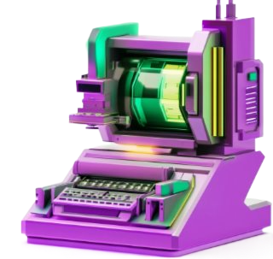
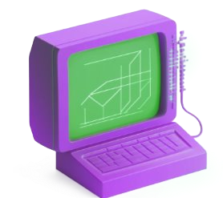
Task responsibilities
PollButtonTask
Sends EVT_BUTTON_PRESS when triggered
StateMachineTask
Processes Incoming Events
AnimateTask
Receives animation requests
Maintains Game State
Decides Next Animation
Executes LED patterns
Sends EVT_ANIM_COMPLETE to the StateMachineTask

Slide 8
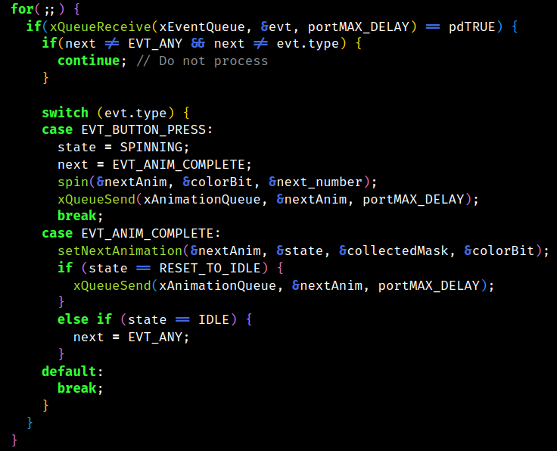
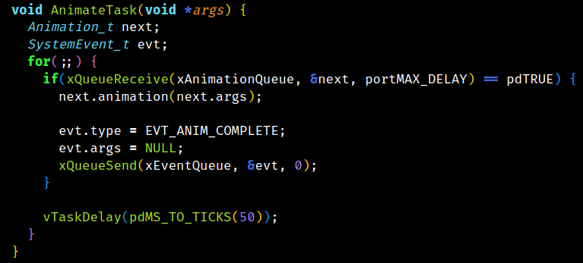
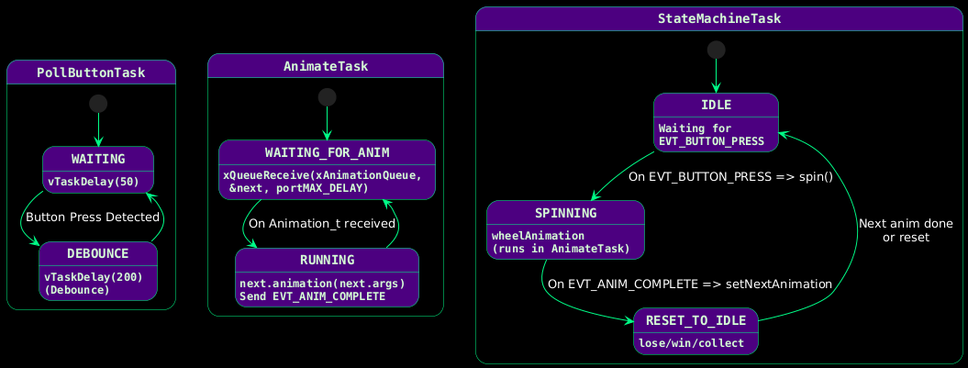

Slide 9
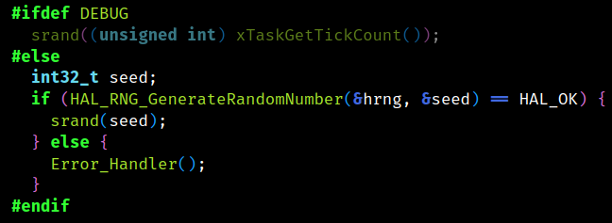
randomness
DEBUG MODE SEEDING
RELEASE MODE SEEDING
WHY IT MATTERS
Uses xTaskGetTickCount() to generate a repeatable seed
Uses the hardware RNG via HAL_RNG_GenerateRandomNumber()
Guarantees game outcomes are independent
Critical for fair gaming

Slide 10
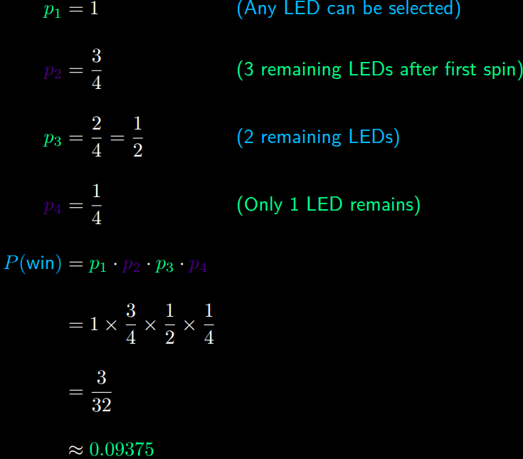
Winning condition
Achieved by collecting all 4 LEDs
Landing on a duplicate results in immediate loss
Uses bitmask to track collected LEDs

Slide 11
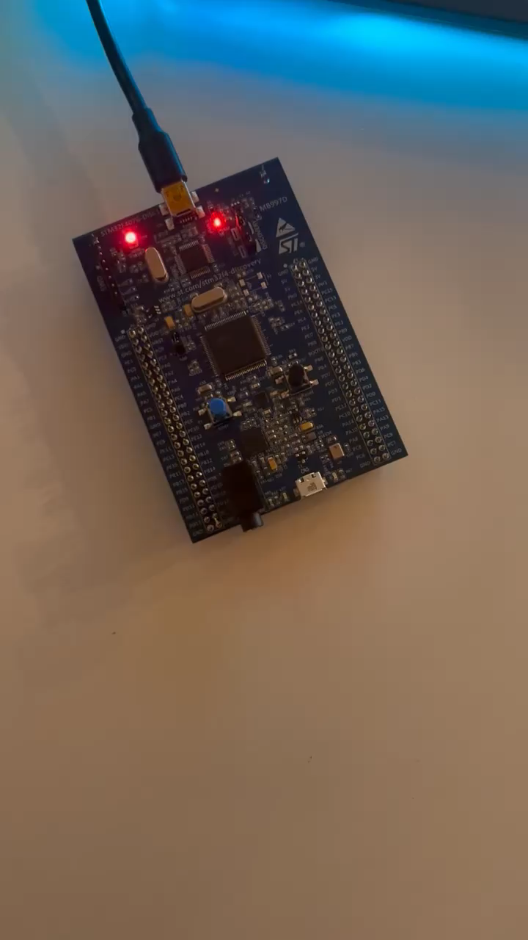

Slide 12
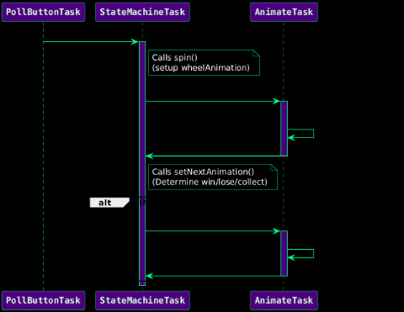
System flow
Button Trigger
PollButtonTask sends Event_t
Spin Init
StateMachineTask calls spin()
Animation Exec
Runs animations and posts Event_t
Outcome Handling
StateMachineTask processes event

Slide 13

conclusion
ACHIEVMENTS
TAKEAWAYS
EDUCATION
Developed moduler, event driven slot machine with FreeRTOS
Task Segregation
Effective Use of Hardware RNG
Clear demonstration of real-time scheduling and state management
Insights into embedded systems

Slide 14

Future work
14
ENHANCED USER INTERFACE
DATA PERSISTENCE
ADVANCED SCHEDULING
Sounds
More Dynamic LED Animations
Implement Non-Volatile Storage
Explore Dynamic Task Scheduling
Extend Design To Support More Game Features
Latta slots

Slide 15

Thank you

Slide 16
TOUR DATES
Sep. 2023
San Francisco, CA
Nov. 2023
Chicago, IL
Jan. 2024
New Orleans, LA
Mar. 2024
Atlanta, GA
May 2024
New York City, NY

Slide 17
Tour
Opening bands
Trash Panda and the Garbage Bags
Hearts and a Bottle
My Gazer Romance
Featured artists
Details
Hailey Clark
Juan Morgan
Nikola Janu

Slide 18



How to
Online
Visit www.greatsiteaddress.com to buy your tickets​
Create a username and password​
Select from general, floor, or box seats
Box Office
get your tix
Visit your local box office to purchase your tickets
Use code DANMEL at the window for 10% off
Sweepstakes
Follow all our social media accounts
Post a video of you singing one of our songs
Tag our accounts for a chance to win free tickets

Slide 19
YOUR CITY
COMING TO
Make sure to follow Daniel Melamed on social media to catch all the newest updates on tours, new music, and more.
Thanks for checking out my site and can't wait to see you at the next show!

Slide 21
randomness
Debug Mode seeding
Release mode seeding
why it matters
Uses xTaskGetTickCount() to generate a repeatable seed
Uses the hardware RNG via HAL_RNG_GenerateRandomNumber()
Guarantees game outcomes are independent
Critical for fair gaming

Slide 22
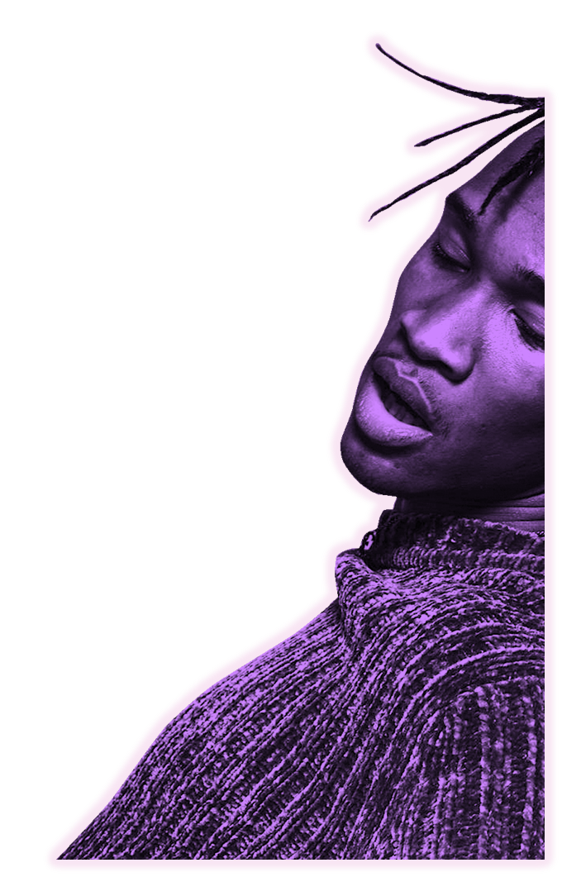
Contact
Daniel Melamed daniel@greatsiteaddress.comwww.greatsiteaddress.com

